Slide 1
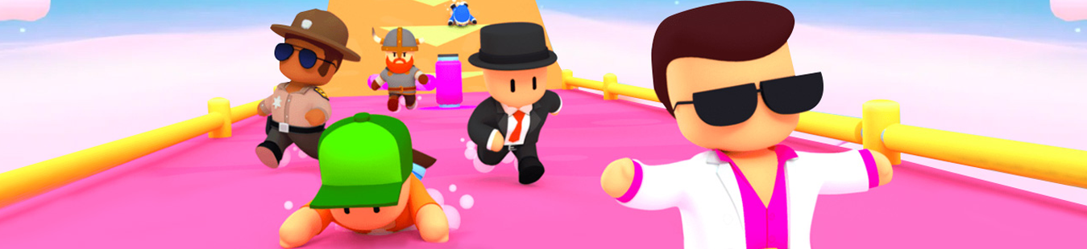
MrB 2 LEVEL - L0 VALIDATION
2023, AUGUST 1st

Slide 2
LEVEL OVERVIEW

Slide 3
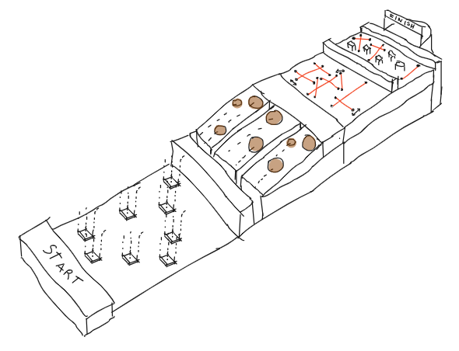
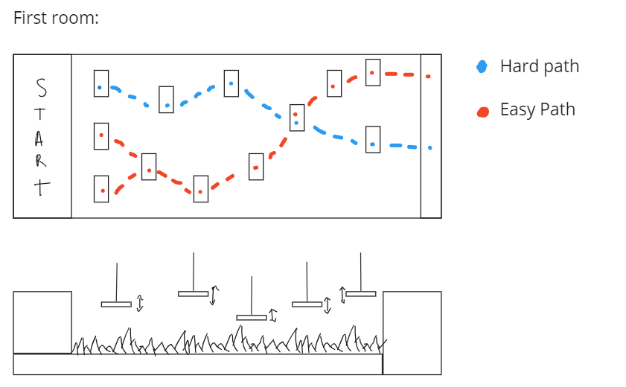
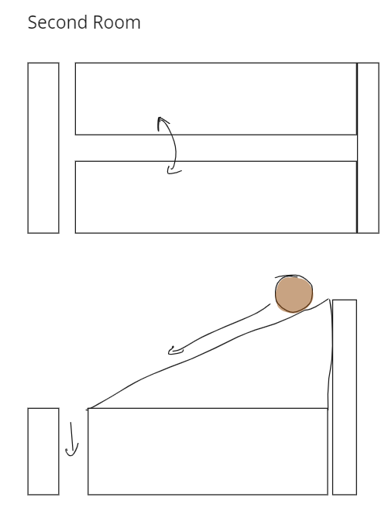
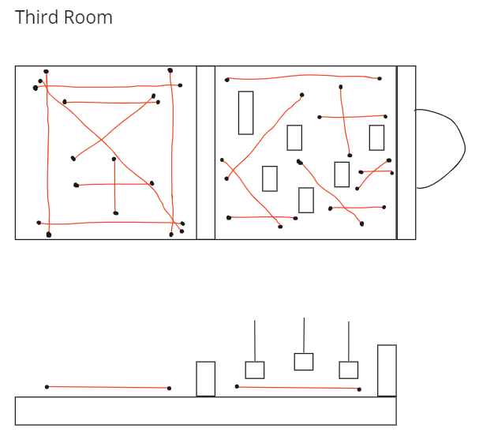
HOW THE LEVEL WORKS
Mode: Race against time
Race level with the time-limit exposed to the player
Qualifying works the same as a race level
Time limit will be close but most players should be able to qualify
Time limit will be represented physically in the level
Phase: 32, 16 i 8 Players
USP:
“Parkour” elements
Fidelity to video
Theme/IP

Slide 4
HOW THE LEVEL WORKS

Slide 5
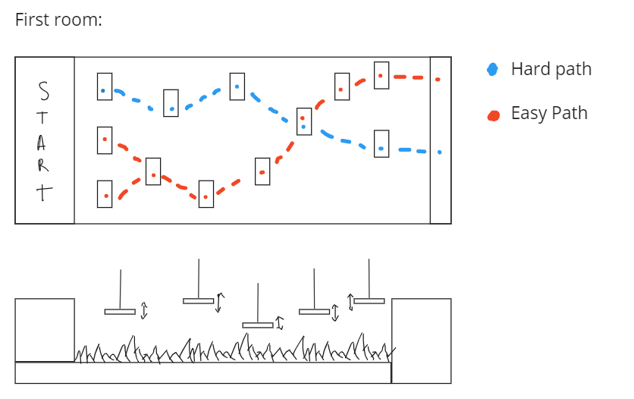
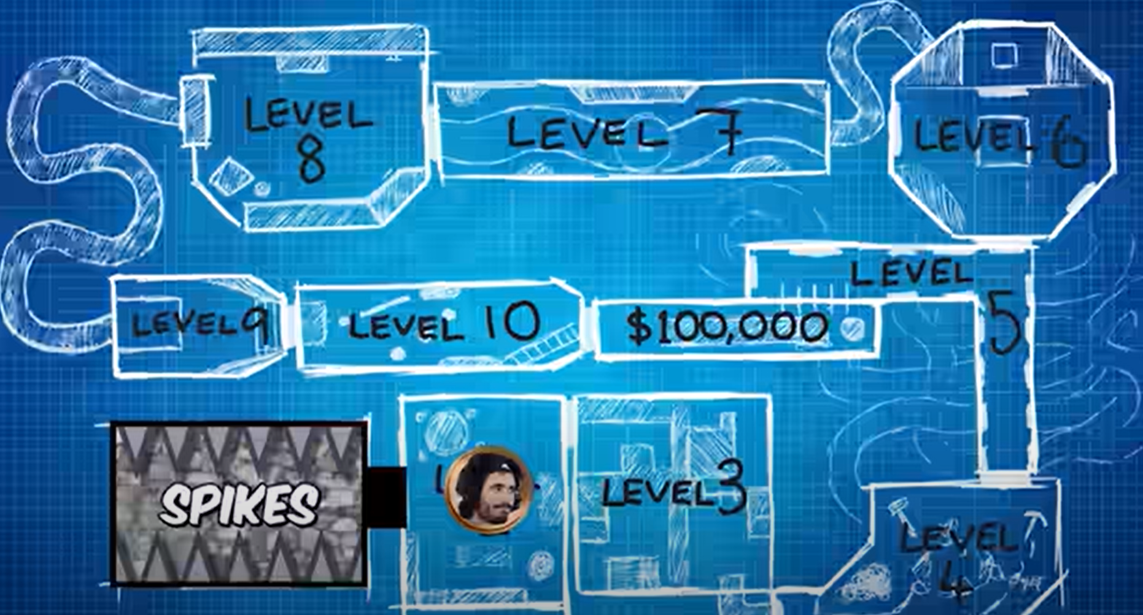
HOW THE LEVEL WORKS: FIRST ROOM
The first room theme will revolve around the Spikes
Area revolves around jumping from platform to platform
Failing to do the jump, will make you fall into the spikes, killing the player and respawning them on the last platform they touched
There will be multiple routes layered out, which will provide a sense of adequate Risk/Reward
Allowing players with higher skill ceilings to clear the area faster, whilst taking on to more risky jumps.
Platforms will have a upwards/downwards movement instead of being static.
This will make it so there is variance to each time you try to make a jump.
World’s Most Dangerous Escape Room Video

Slide 6
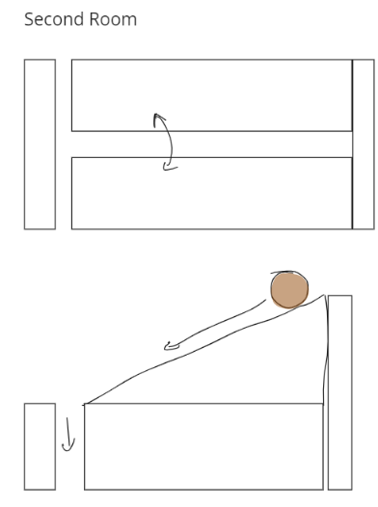
HOW THE LEVEL WORKS: SECOND ROOM
The second room theme will revolve around the Boulders that will roll down the paths
There will be multiple identical paths running uphill.
On top of these paths will drop the boulders.
The players can switch lanes at any point.
The boulders will drop in a pattern, different for each path.
There will be different kind of Boulders.
A enormous Boulder will force players to swap lanes
Fire Boulders that will kill players upon impact
Breakable Boulders, players can break these by punching, dashing or kicking through it.

Slide 7
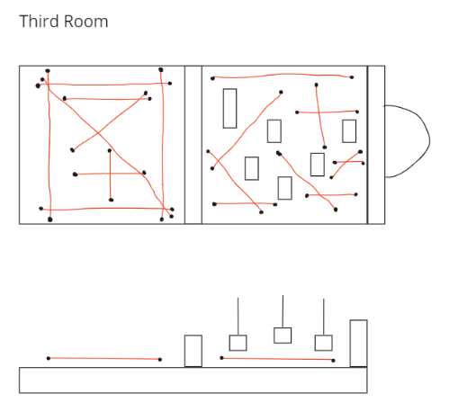
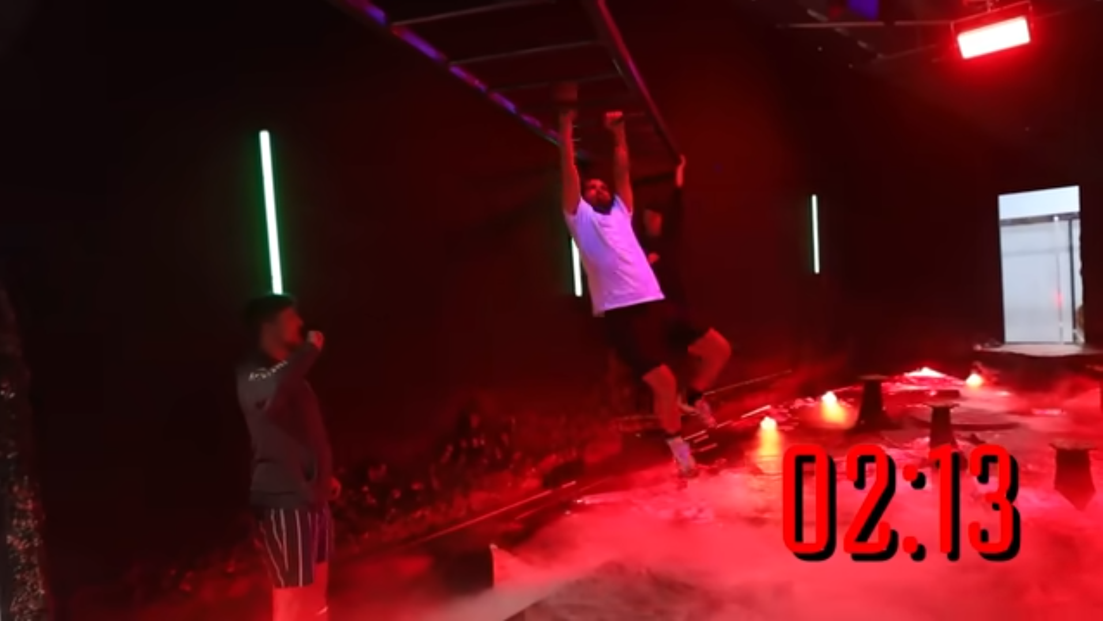
HOW THE LEVEL WORKS: THIRD ROOM
The third room theme will revolve around lasers.
The room will be divided into two areas
Base area, where there will be multiple “safe spots” with lasers around. The lasers will turn on and off, allowing players to get to those safe-spots.
The second area, players will have to perform several very difficult jumps to be able to clear it without falling. Once they fall though they won’t die, the bottom floor will be plagued with moving lasers that they will have to dodge in order to complete the area.
Respawn will be set up so players will only have one try at completing the jumps.
World’s Most Dangerous Escape Room Video

